Slide 1
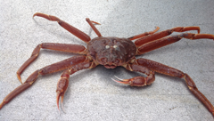
2025-05 Tanner Crab Report
William Stockhausen
AFSC/NMFS/NOAA
May 12, 2025

Slide 2
Topics
New Analyses
GMACS Tanner model development
TCSAM02 alternative models
Proposed models for 2025 assessment
Likelihood profiles (if time permits)

Slide 3
Recent Work
SSC/CPT Requests Addressed
Develop GMACS model that matches current assessment model
substantial progress (but not completely finished)
Use BSFRF SBS selectivity analysis to provide priors on NMFS selectivity
partial: model 25_02 uses estimated capture probability curves
Show OSA residuals and diagnostics for size compositions
Develop likelihood profiles for model(s)
Compare “successful” and “unsuccessful” cohorts
Other
Compare AKFIN and crabpack data pulls (SAP request)
GMACS code
fixed issues with time blocks for survey catchability
added “zero pop” start option to match TCSAM02
added ascending normal selectivity curve option

Slide 4
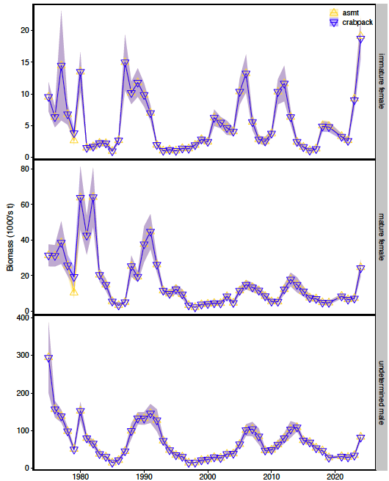
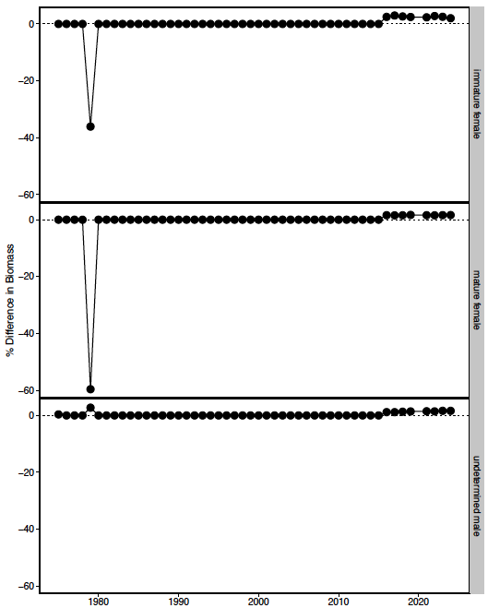
crabpack comparisons
Recommendations
1979: use standard stations
2016+: use best precision to convert CW to weight

Slide 5
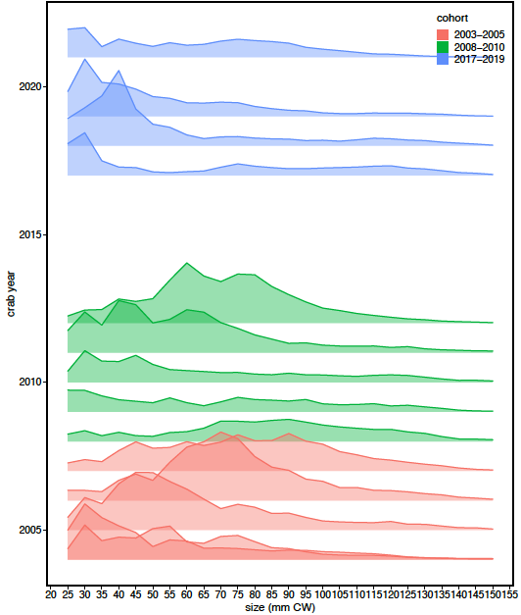
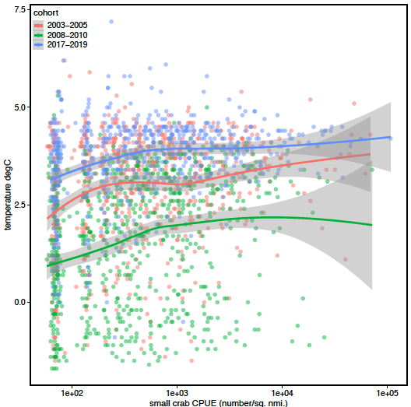
“successful” cohorts
”unsuccessful”
”successful”

Slide 6
Progress toward a GMACS model for Tanner crab
Notes:
2022

Slide 7
2024 assessment model time frames: model processes
Notes:
updated 2024

Slide 8
2024 assessment model: data time frames
Notes:
2022

Slide 9
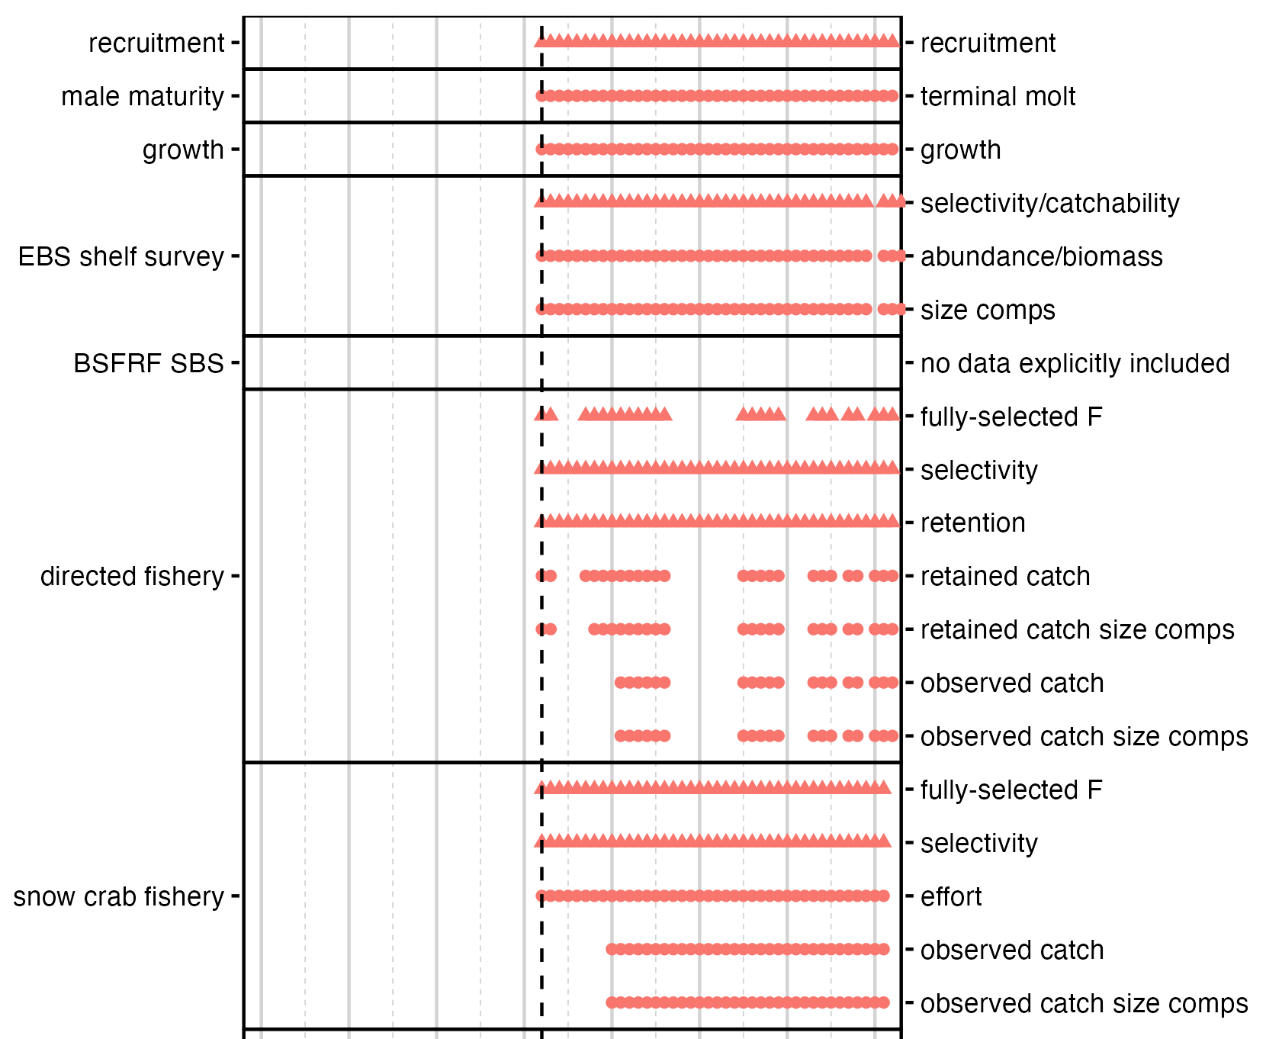
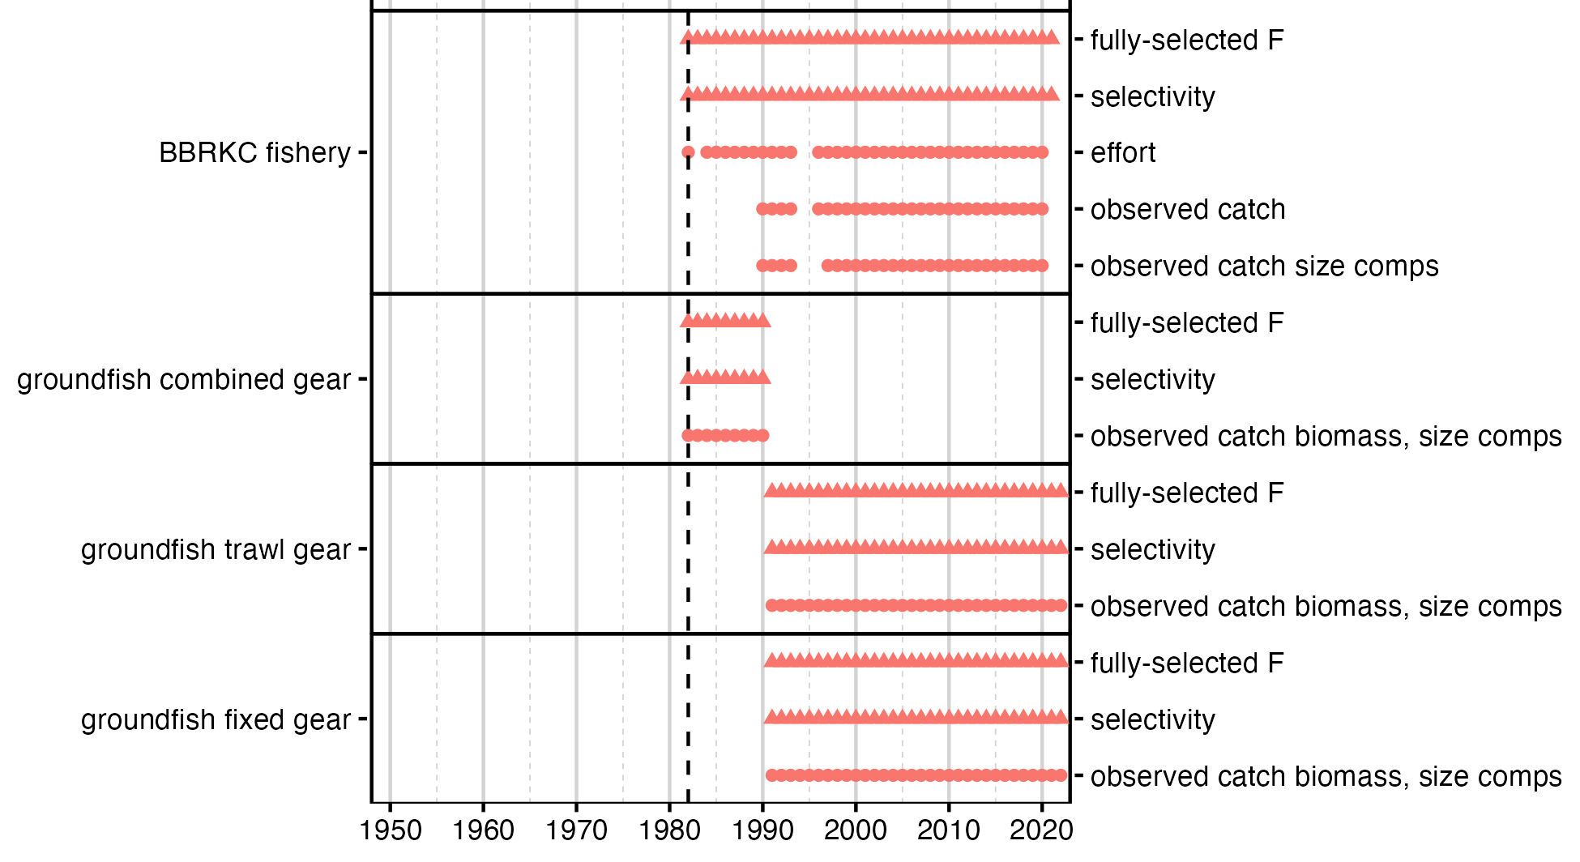
May 2024: simplified GMACS model
Notes:
2022

Slide 10
Population dynamics
Notes:
2025

Slide 11
Fisheries
Notes:
2025

Slide 12
Fisheries
Notes:
2025

Slide 13
Surveys
Notes:
2025

Slide 14
Likelihoods
Penalties??
Notes:
2022

Slide 15
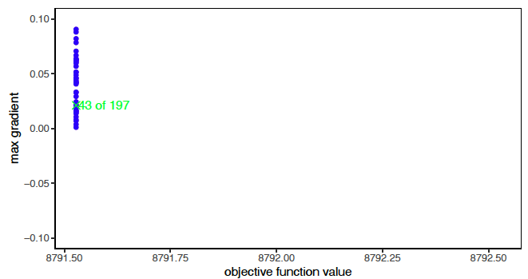
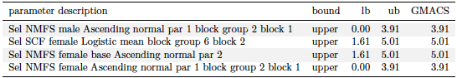
GMACS Model
Notes:
2022

Slide 16
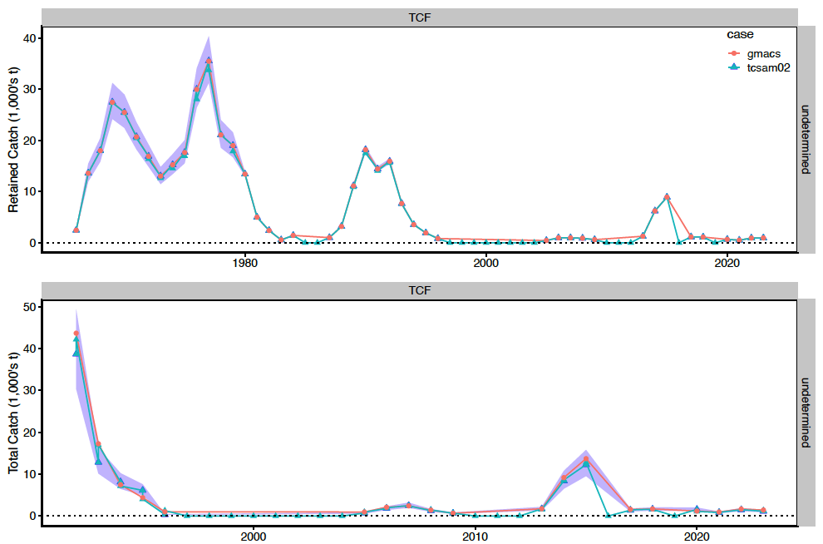
GMACS Model
Retained catch
Fits to Directed Fishery
Catch Biomass
Total catch
Notes:
Fits to retained (upper) and total (lower) catch in the directed fishery.

Slide 17
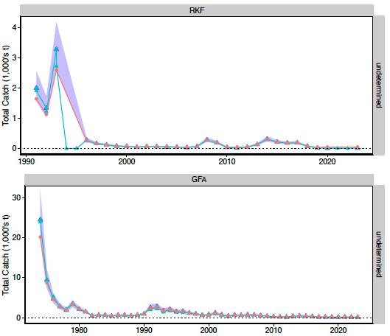
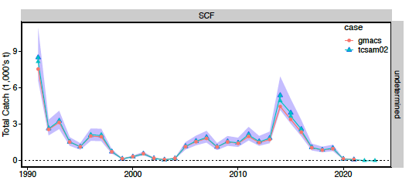
GMACS Model
BBRKC fishery
Fits to total bycatch
snow crab fishery
groundfish fisheries
Notes:
Fits to total bycatch time series in other fisheries

Slide 18
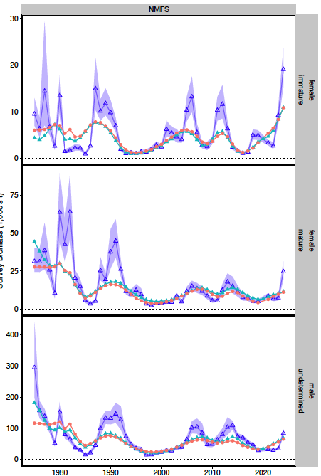
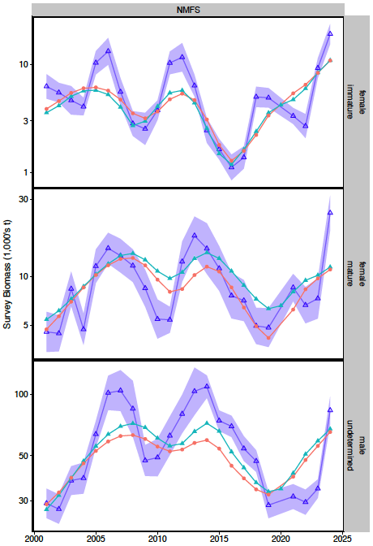
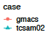
GMACS Model
immature females
NMFS
Survey
Biomass
mature females
mature males
Notes:
2022

Slide 19
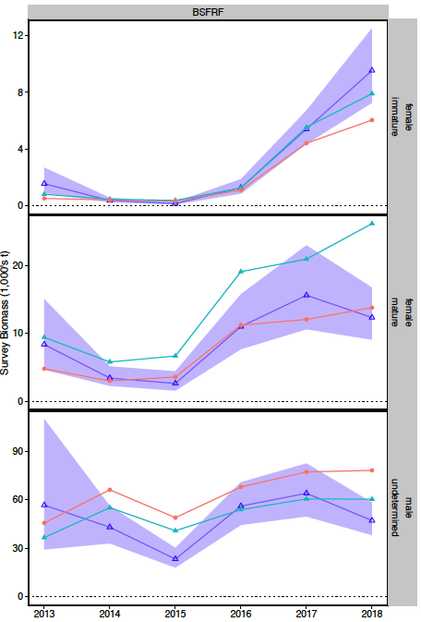
GMACS Model
BSFRF
Survey
Biomass
Notes:
2022

Slide 20
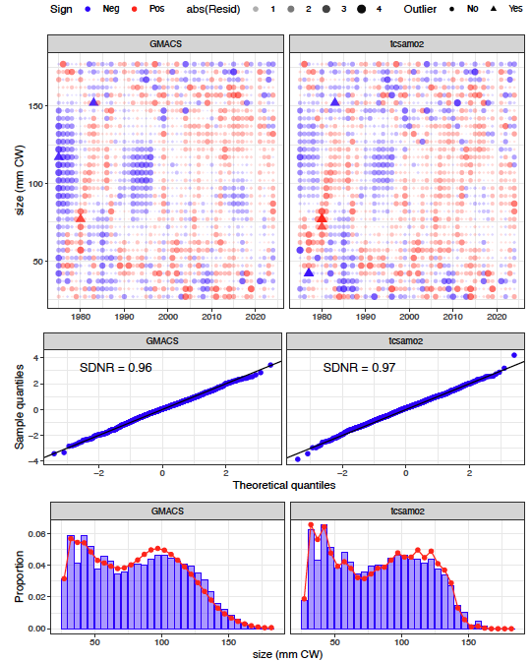
GMACS Model
Males
NMFS
Survey
Size Comps
Notes:
NMFS survey

Slide 21
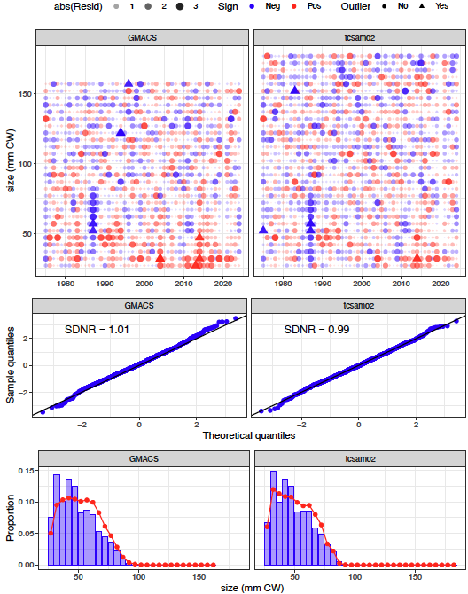
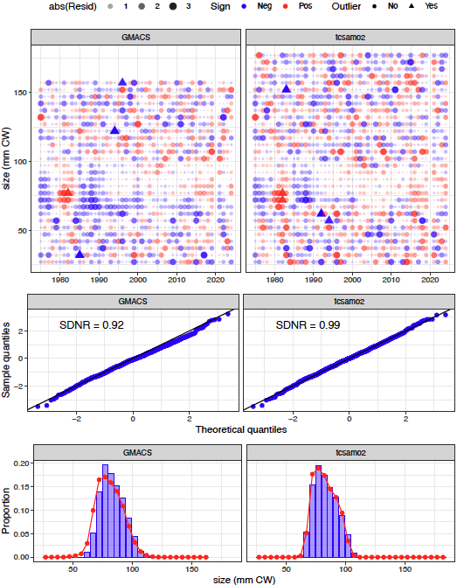
GMACS Model
Immature Females
Mature Females
NMFS
Survey
Size Comps
Notes:
NMFS survey

Slide 22
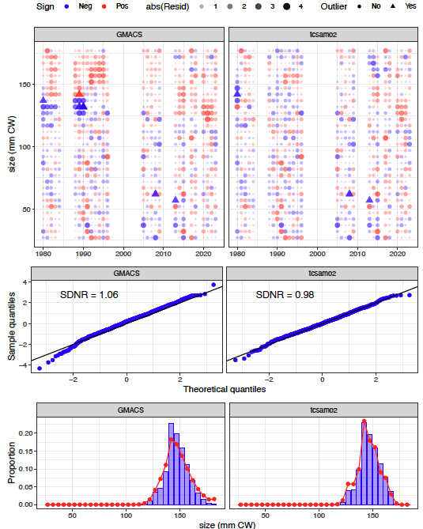
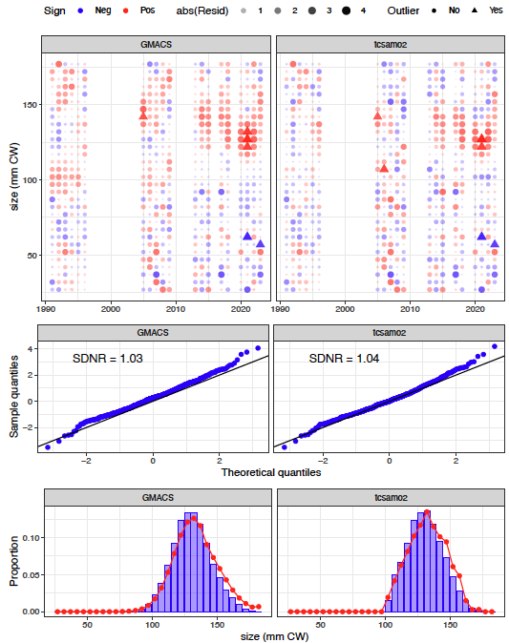
GMACS Model
retained
total catch (males)
Directed
Fishery
Size Comps
Notes:
Directed fishery: retained catch (left columns); total catch (right columns)

Slide 23
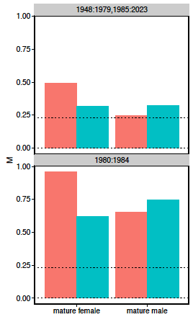
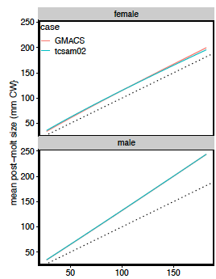
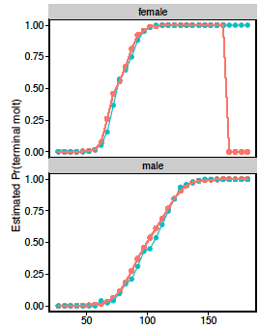
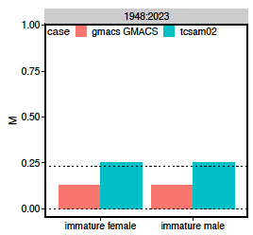
GMACS Model
Model Processes
natural mortality
growth
molt to maturity
size (mm CW)
Notes:
2022

Slide 24
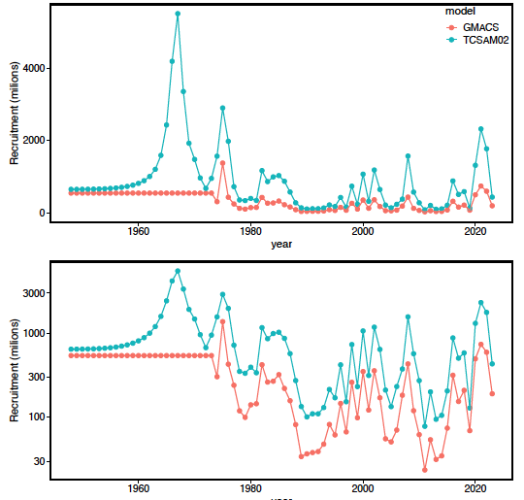
GMACS Model
Estimated
Recruitment
arithmetic scale
log-scale
Notes:
2022

Slide 25
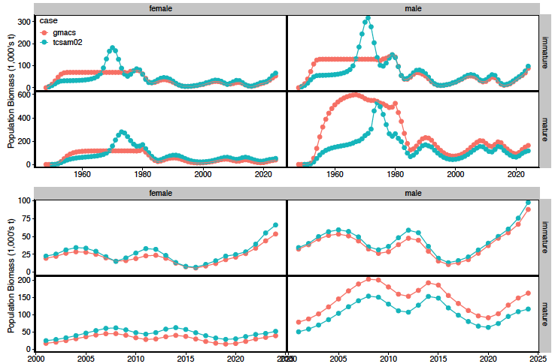
GMACS Model
Estimated
Population
Biomass
Notes:
2022

Slide 26
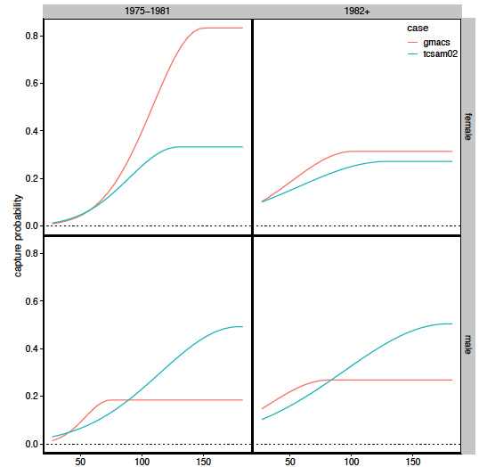
GMACS Model
Estimated
NMFS Survey
Capture Probability
Curves
Notes:
2022

Slide 27
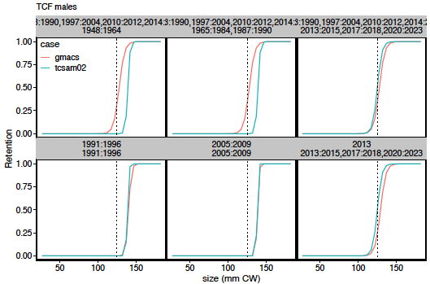
GMACS Model
Estimated
Directed Fishery
Retention Curves
Notes:
2022

Slide 28
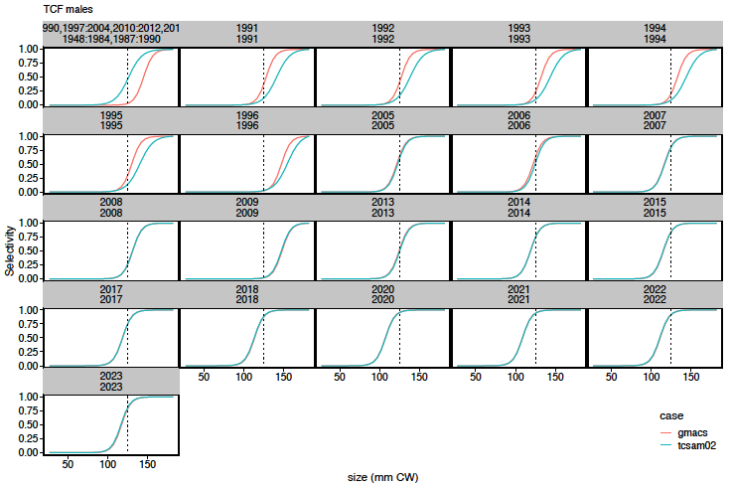
GMACS Model
Estimated
Directed Fishery
Selectivity Curves
(males)
Notes:
Total catch selectivity curves for directed fishery

Slide 29
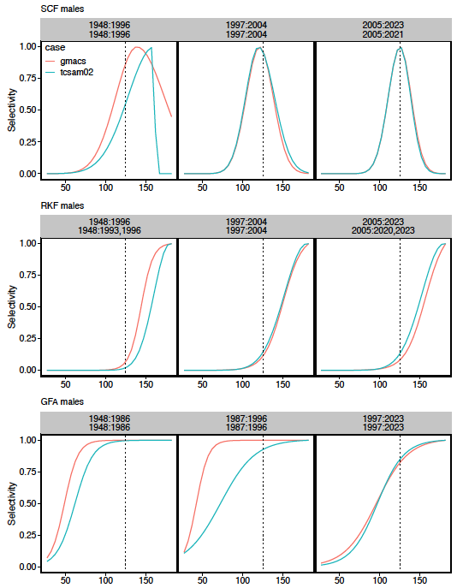
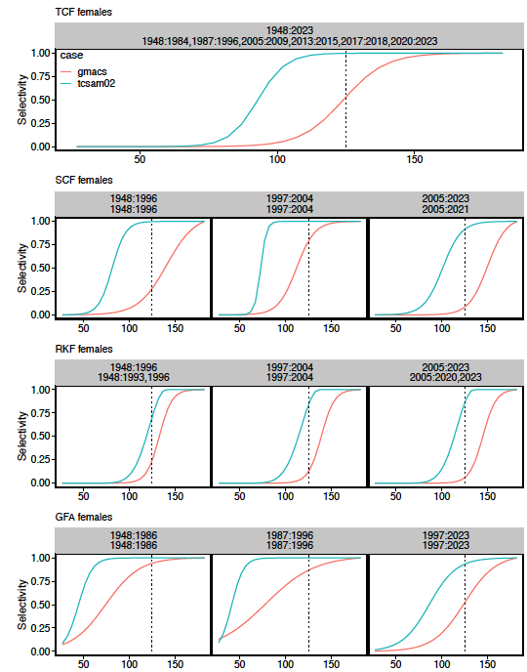
GMACS Model
males
females
Estimated
Bycatch
Selectivity Curves
Notes:
2022

Slide 30
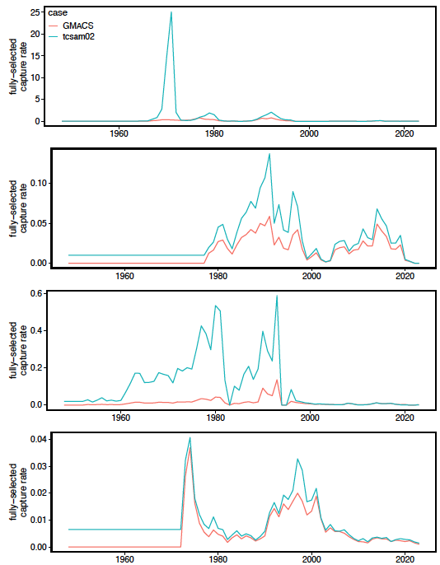
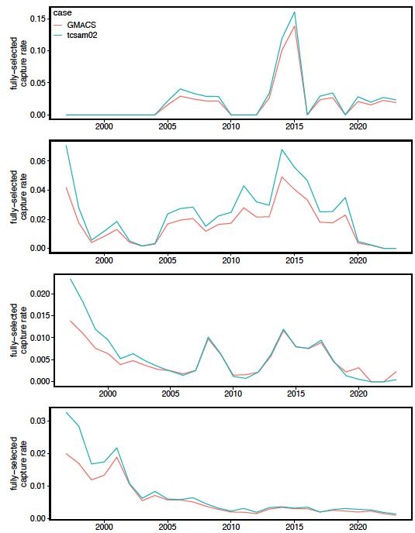
GMACS Model
directed
fishery
Estimated
Fishing Mortality
Rates
snow
crab
BBRKC
groundfish
Notes:
2022

Slide 31
GMACS Model
Summary
Model structures are pretty well matched
similar time blocks
similar parameters and functions
Model fits to data are similar
Estimated temporal population variability/trends are similar
Overall scales are mismatched
Issues appear related to
differences with treatment of recruitment during model “spin-up”
selectivity/catchability estimation
Differences in penalties??
Notes:
2022

Slide 32
TCSAM02 Models
Notes:
2022

Slide 33
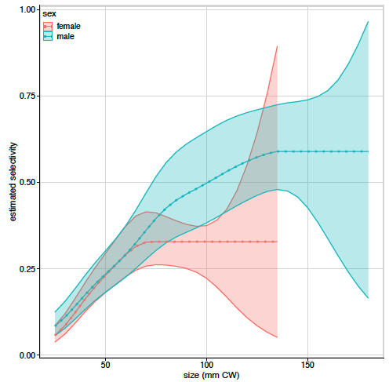
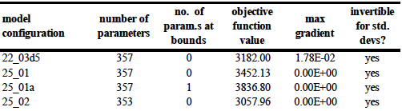
TCSAM02 Models
2025
Assessment
Model
Used SBS-derived catchability curves for NMFS survey
No tail compression
survey observations
normally-distributed
22.03d5
25_01
25_01a
25_02
357
357
357
353
Notes:
Candidate alternative models

Slide 34
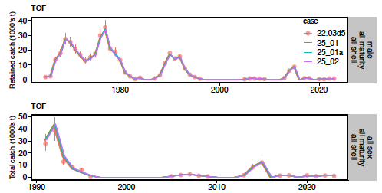
TCSAM02 Models
Fits to directed fishery catch biomass
Notes:
Fits to directed fishery retained and total catch biomass

Slide 35
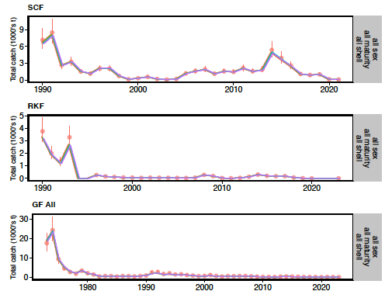
TCSAM02 Models
Fits to
catch biomass
in bycatch fleets
Notes:
2022

Slide 36
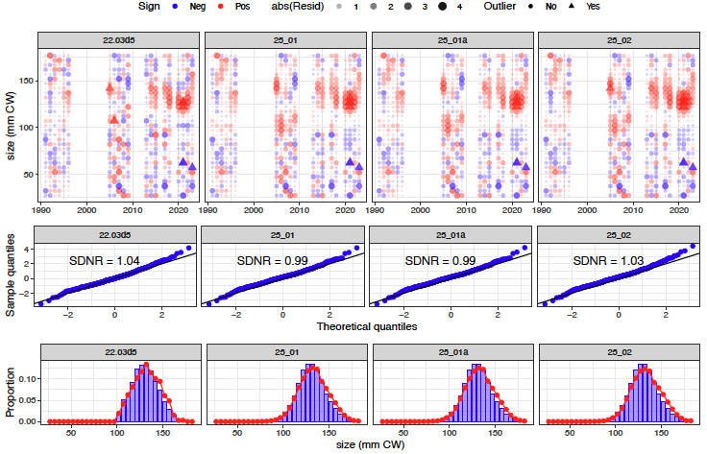
TCSAM02 Models
Fits to male
size comps
in directed fishery
Notes:
total catch in directed fishery, males

Slide 37
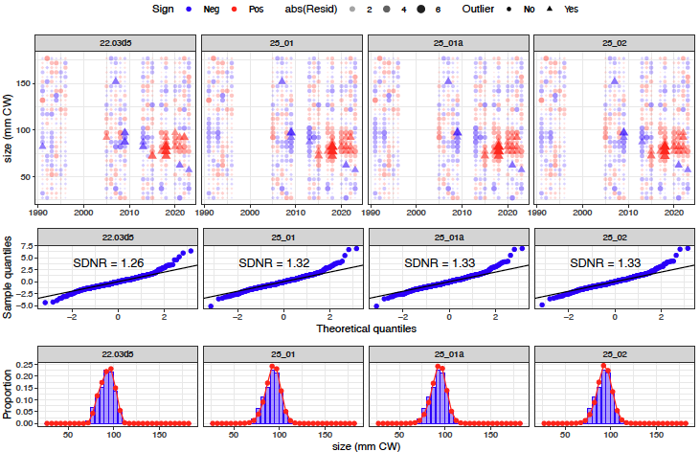
TCSAM02 Models
Fits to female
size comps
in directed fishery
Notes:
females, directed fishery total catch

Slide 38
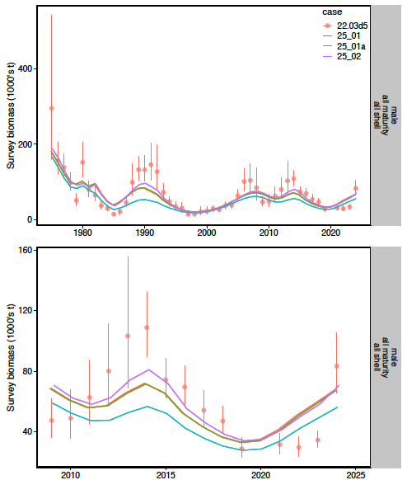
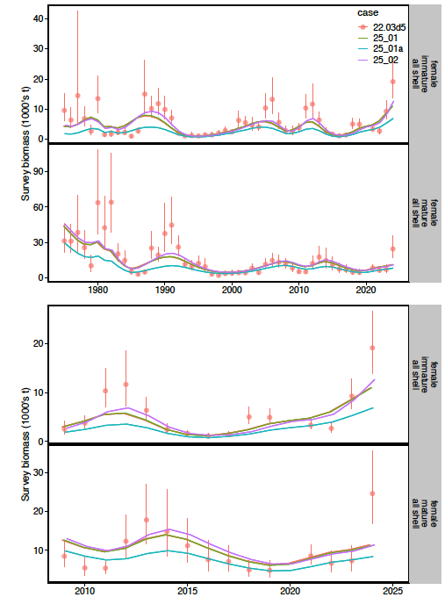
TCSAM02 Models
males
females
Fits to NMFS
survey biomass
Notes:
Fits to survey data

Slide 39
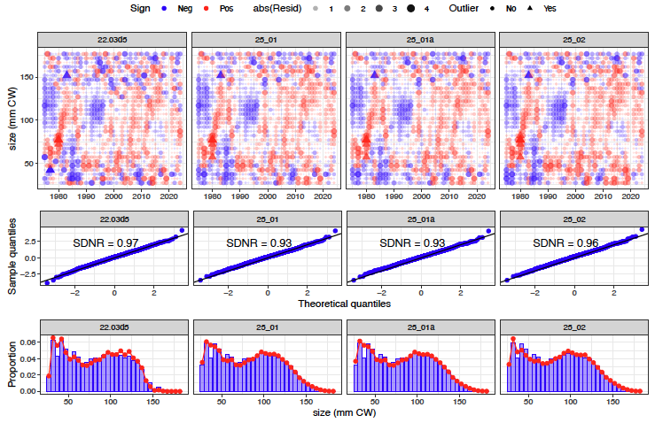
TCSAM02 Models
Fits to male
size comps
in NMFS survey
Notes:
2022

Slide 40
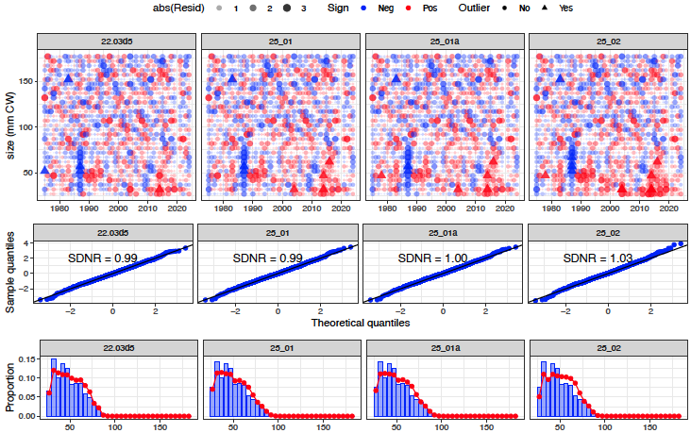
TCSAM02 Models
Fits to immature female
size comps
in NMFS survey
Notes:
OSA residuals for TCSAM02 models’ fits to immature female size compositions from the NMFS survey. The base model is
22.03d5.

Slide 41
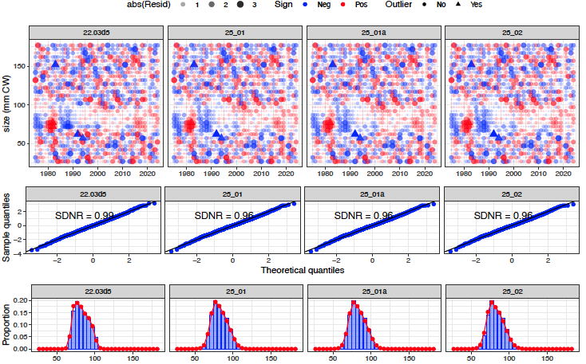
TCSAM02 Models
Fits to mature female
size comps
in NMFS survey
Notes:
OSA residuals for TCSAM02 models’ fits to mature female size compositions from the NMFS survey. The base model is
22.03d5.

Slide 42
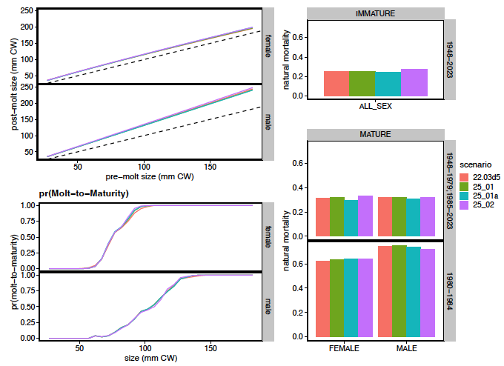
TCSAM02 Models
growth
natural mortality
Estimated
model
processes
Notes:
2022

Slide 43
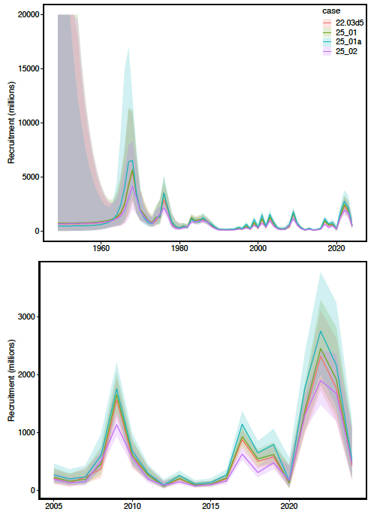
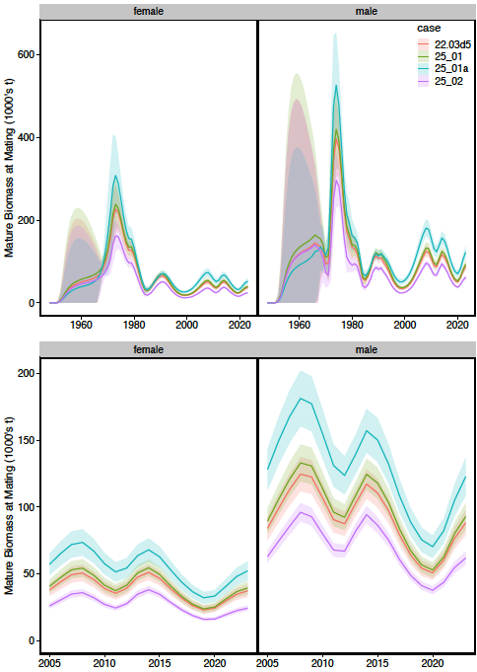
TCSAM02 Models
Recruitment
Mature Biomass
Estimated
model
processes
Notes:
2022

Slide 44
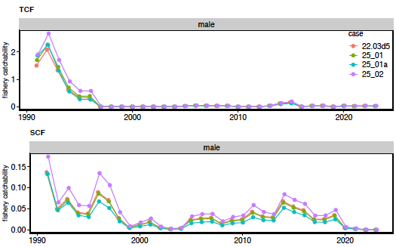
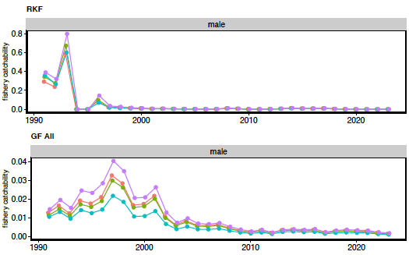
TCSAM02 Models
Fishery Catchability
Notes:
2022

Slide 45


TCSAM02 Models
Fishery Selectivity
Snow Crab Fishery
Directed
Fishery
(males)
Notes:
2022

Slide 46


TCSAM02 Models
Estimated NMFS Survey Capture Probability Curves
males
females
Notes:
2022

Slide 47
TCSAM02 Models
Summary
25_01: tail compression has little effect on estimated quantities
25_01a: normal error distributions result in poor fits
25_02: SBS-derived NMFS survey capture probabilities result in
lower scales for population estimates
higher scale for fishery catchability estimates
otherwise, fits and estimates are similar to those of the assessment model
Notes:
2022

Slide 48
Proposed Tier 3 models for September
2024 assessment model (TCSAM02 22.03d5) is “base” model
update with 2024/25 fishery/survey data
TCSAM02 25_02 model
with SBS-derived NMFS survey capture probabilities
GMACS G25_05
resolve scaling differences with TCSAM02 model
provide complete analysis
management quantities,
retrospective patterns, etc
Notes:
2022

Slide 49







2024 Assessment Model: Likelihood Profiles
Directed Fishery
NMFS Survey Females
NMFS Survey Males
Total Likelihood
ln-scale recruitment parameter
Notes:
Likelihood profile results for objective function components in 2024 assessment model

Slide 50








2024 Assessment Model: : Likelihood Profiles
recruitment parameters
growth parameters
natural mortality parameters
survey catchability parameters
ln-scale recruitment parameter
Notes:
Likelihood profile results for parameter changes in the 2024 assessment model.
pLnR[1]: historical recruitment period. pRa[1]: fixed value. pRb[1]: fixed value.
pGrA[1]: males. pGrA[2]: females. pGrB[1]: males. pGrB[2]: females. pGrBeta[1]: both sexes.
pDM1[1]: multiplier for immature crab. pDM1[2]: multiplier for mature males. pDM1[3]: multiplier for mature females.
pDM2[1]: 1980-1984 multiplierfor mature males. pDM2[2]: 1980-1984 multiplier for mature females.
pQ[1]: NMFS trawl survey: males, 1975-1981. pQ[2]: NMFS trawl survey: males, 1982+.
pQ[3]: NMFS trawl survey: females, 1975-1981. pQ[4]: NMFS trawl survey: females, 1982+.

Slide 51

2024 Assessment Model: LPs
ln-scale recruitment parameter
Notes:
Likelihood profile results for management quantity changes in the 2024 assessment model.
avgRec: average recruitment, B100: unfished biomass, curB: current biomass, Fmsy: directed fishing mortality that results in MSY,
Fofl: directed fishing mortality that results in the OFL, MSY: maximum sustainable yield, OFL: overfishing limit, prjB: projected biomass.

